Slide 1
03: Quaternions
Dr. Hamish Carr & Dr. Rafael Kuffner dos Anjos

Slide 2


Agenda
Shortcomings of other rotation methods
Quaternion operations
Rotations with quaternions
COMP 5812M: Foundations of Modelling & Rendering

Slide 3
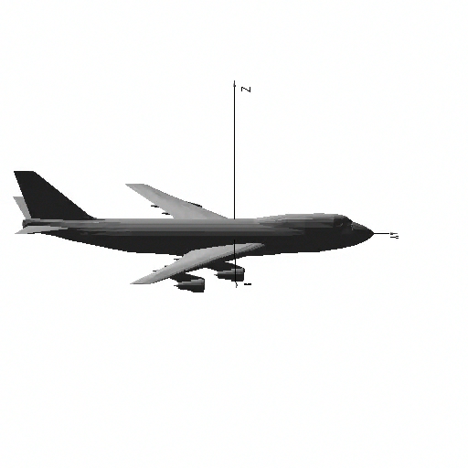
Euler Angles
Euler angles: rotate around global x, y, z
But we get gimbal lock: ambiguous roll & yaw
interpolation becomes degenerate

Slide 4
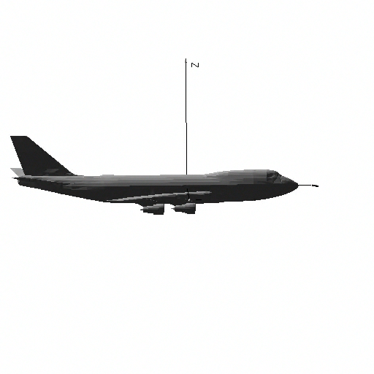
Cardan Angles
Rotation around x, y, z in fixed order
180º pitch + 180º yaw = 180º roll

Slide 5
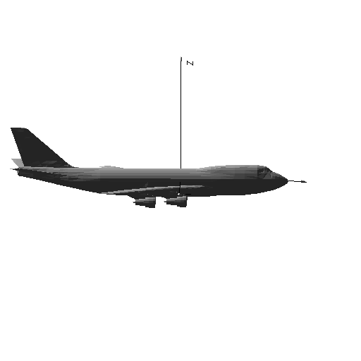
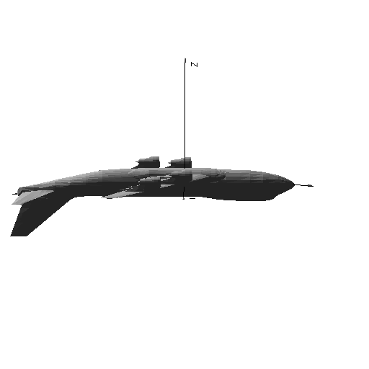
Keyframe Interpolation
Initial Rotation:
Pitch = 0
Yaw = 0
Roll = 0
Final Rotation:
Pitch = 180
Yaw = 180
Roll = 0
Intermediate Rotation:
Pitch = n
Yaw = n
Roll = 0

Slide 6
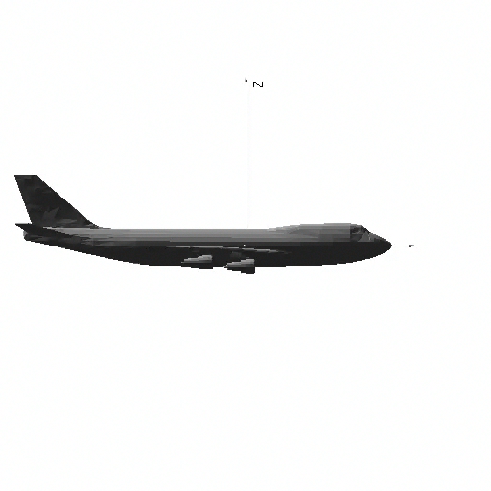
Cardan Interpolation
Cardan angles are not unique
One orientation, multiple representations
Worst-case behaviour is pretty awful

Slide 7
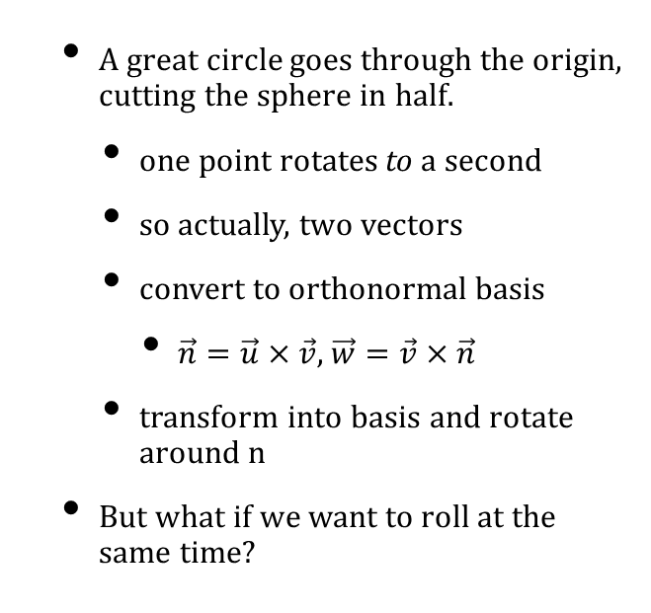
Great Circle Rotation
A great circle goes through the origin, cutting the sphere in half.
one point rotates to a second
so actually, two vectors
convert to orthonormal basis
$\vec{n}=\vec{u}×\vec{v}$, $\vec{w}=\vec{v}×\vec{n}$
transform into basis and rotate around n
But what if we want to roll at the same time?

Slide 8
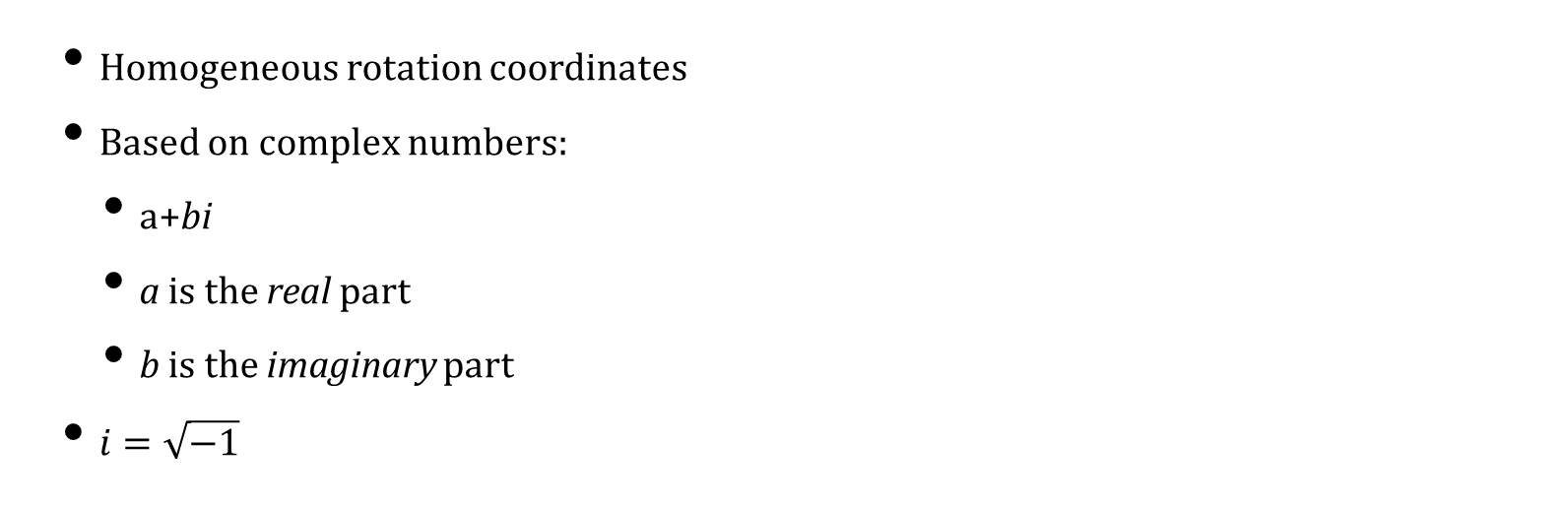
Quaternions
Homogeneous rotation coordinates
Based on complex numbers:
a+bi
a is the real part
b is the imaginary part
$i=\sqrt{−1}$

Slide 9
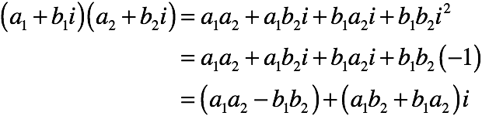
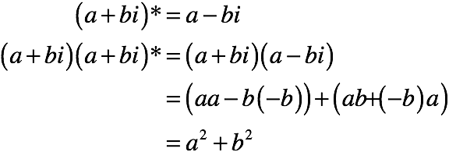
Complex Operations
Addition:
Multiplication:
Conjugation:

Slide 10
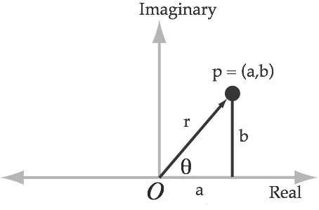
Spatial Interpretation
Treat as points in 2D:

Slide 11
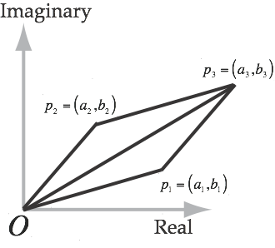
Spatial Addition
Complex Addition:
Is translation!
(or vector addition)

Slide 12
Polar Multiplication

Slide 13
Polar Multiplication

Slide 14
What about Theta?

Slide 15
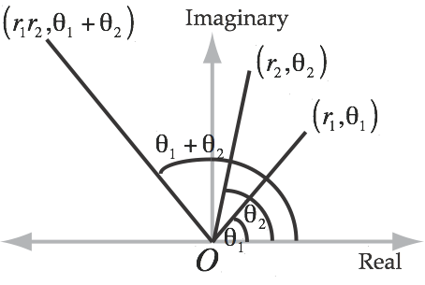
Geometric Interpretation
Multiplication gives
Scaling
Rotation
Based on polar notation

Slide 16
Extending to 3-D
We’ll look at complex conjugates:
Does this work for 3 coordinates?

Slide 17
The Fourth Coordinate
We need bcij and bcji to cancel out
So we add a fourth coordinate:
And get quaternions with four coordinates:
a + bi + cj + dk

Slide 18
With Quaternions
Now it all works!

Slide 19
Quaternion Operations
Addition:
Multiplication:

Slide 20
Geometric Interpretation
i,j,k are different from 1:
i becomes j becomes k becomes i
looks like rotating between x, y, z
In a quaternion q=(w,x,y,z)
w: the scalar part
(x,y,z): the vector part
COMP 5812M: Foundations of Modelling & Rendering

Slide 21
Notation
Scalar s:
Vector v:
Quaternion q:

Slide 22
Properties
Scalar multiplication:
Associativity & Distributivity:
Anti-commutativity:

Slide 23
Conjugation

Slide 24
Vector Multiplication

Slide 25
More Multiplication

Slide 26
Norm & Inverse

Slide 27
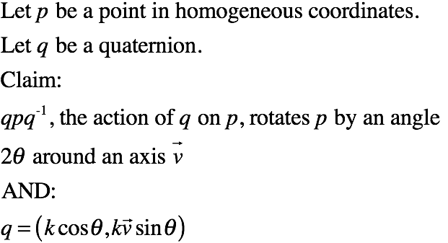
Action of a Quaternion

Slide 28
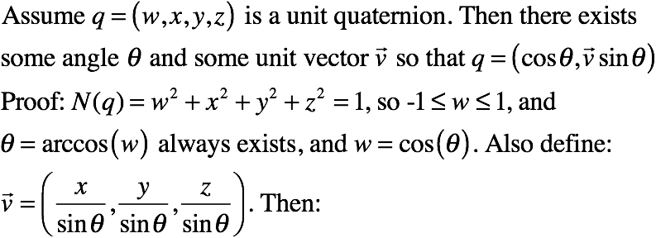
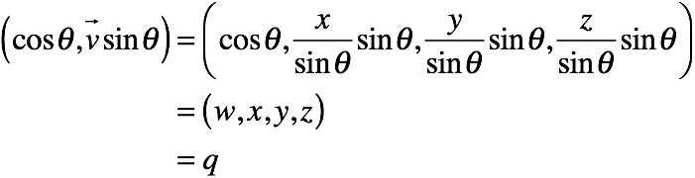
Lemma 1
COMP 5812M: Foundations of Modelling & Rendering

Slide 29
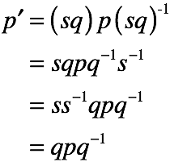
Lemma 2
For any s≠0, q and sq have the same action
I.e. quaternions are homogeneous in nature

Slide 30
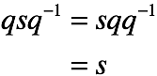
Lemma 3
Assume q is a unit quaternion. It’s action on a scalar is:

Slide 31
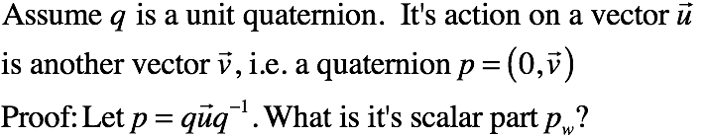
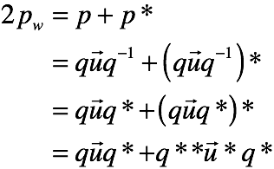
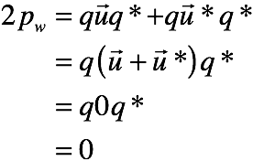
Lemma 4
COMP 5812M: Foundations of Modelling & Rendering

Slide 32
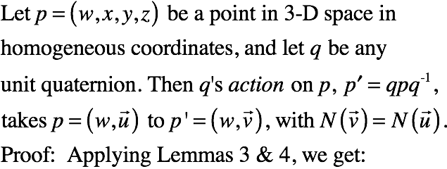
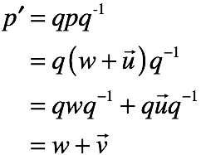
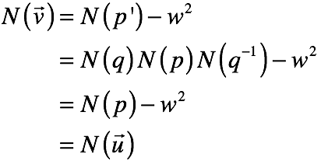
Lemma 5

Slide 33
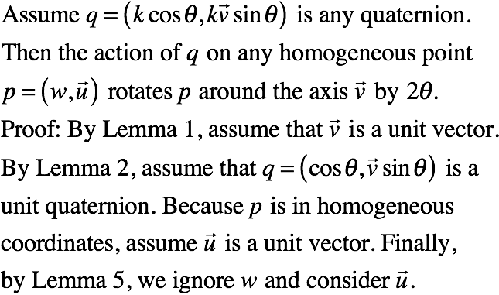
Theorem

Slide 34
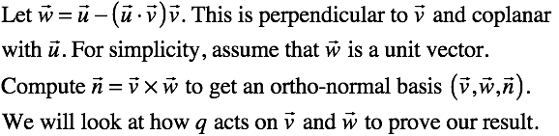
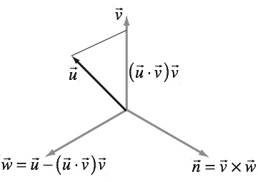
Finding a Basis

Slide 35
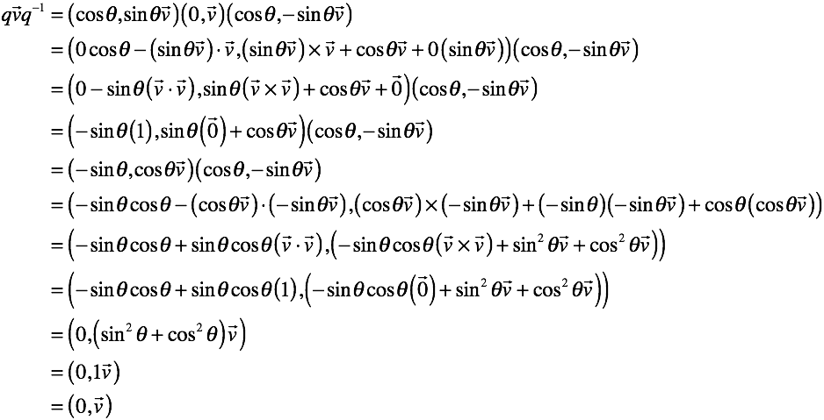
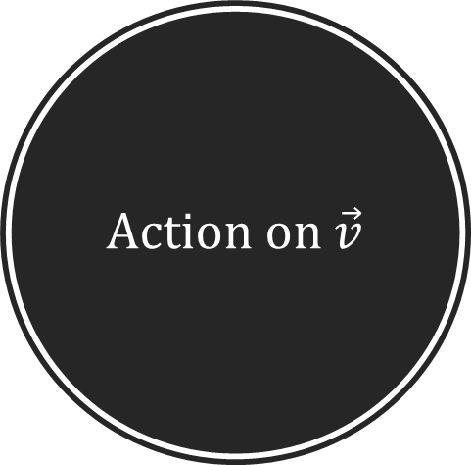
Action on $\vec{v}$

Slide 36
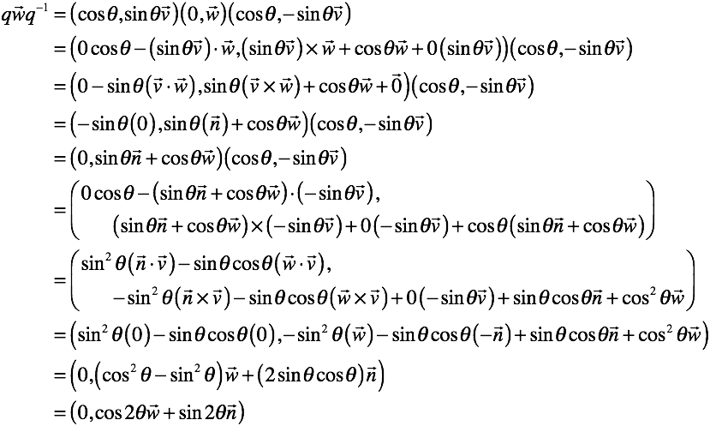

Action on $\vec{w}$

Slide 37
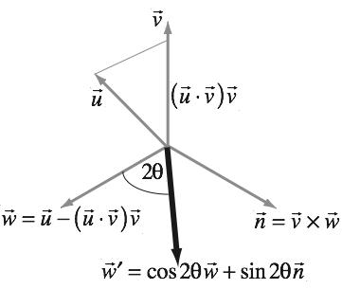
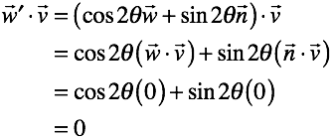
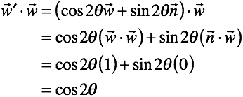
Interpretation

Slide 38
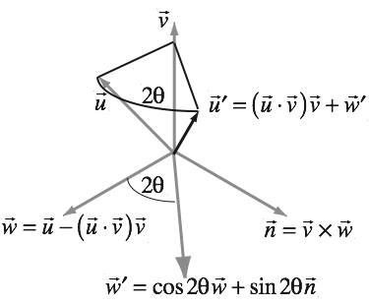
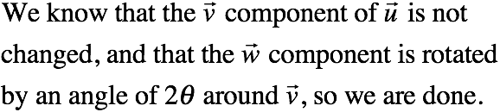
Action in General
COMP 5812M: Foundations of Modelling & Rendering

Slide 39
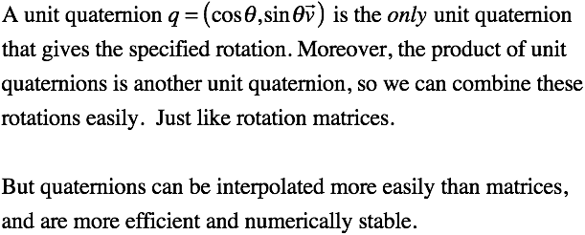
Uniqueness
COMP 5812M: Foundations of Modelling & Rendering

Slide 40
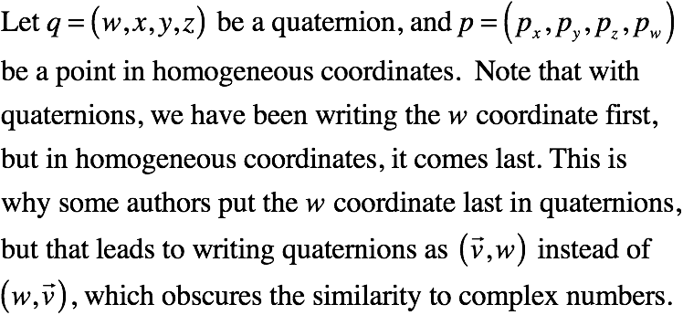
Quaternion to Matrix

Slide 41
Left-Multiplication
Converting the
quaternion to a
matrix multiplication:

Slide 42
Right-Multiplication

Slide 43
Full Action

Slide 44
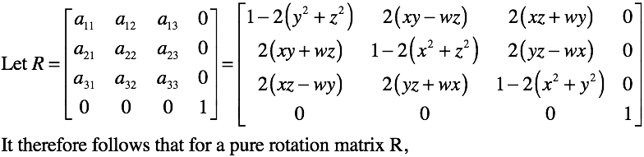
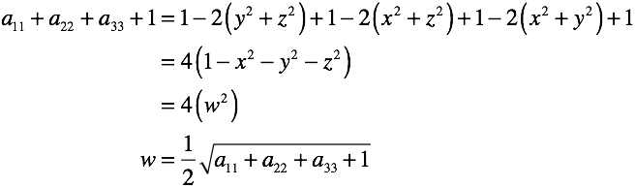
Rot. Matrix to Quaternion

Slide 45
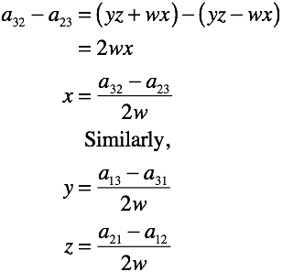
Finding x, y, z:

Slide 46
Spherical Interpolation
Quaternions rotate on great circles
Assume that:
q defines the entire rotation
we want to interpolate in n steps

Slide 47
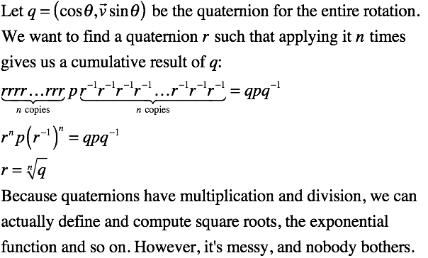
Exponential Solution

Slide 48
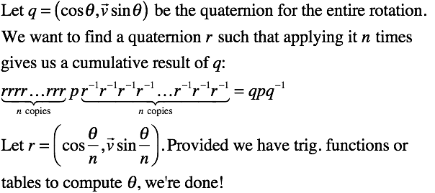
Interpolation Hack

Slide 49
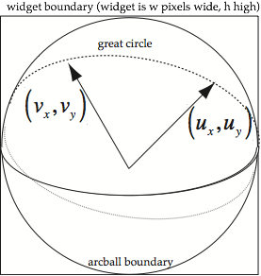
Arcball Controller
An arcball rotation consists of two mouse-clicks: start (u) and end (v)
This gives a rotation along the great circle between u and v

Slide 50
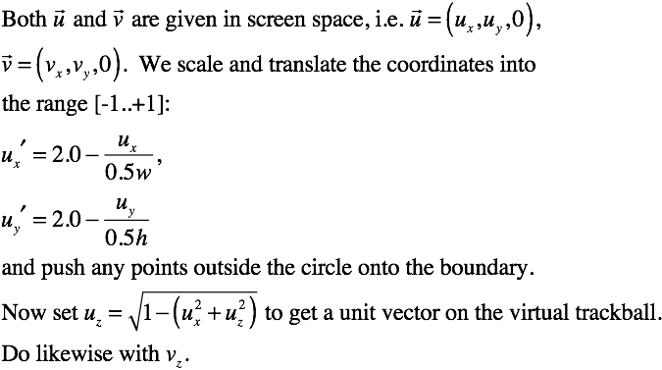
2D to 3D

Slide 51
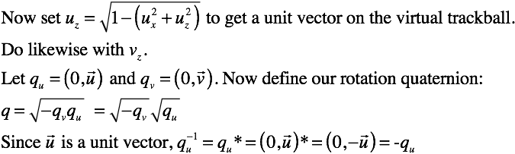
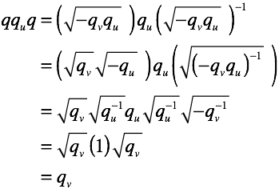
Computing a Quaternion
Look at slide 46!

Slide 52
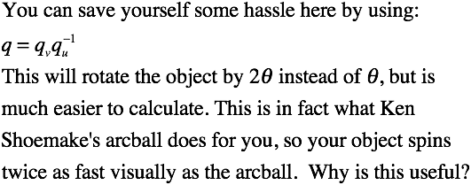
Arcball Version

